Slide 1

Senior Product Manager (CDS) Case Challenge
Created by:
Maleo Fibula Mustafa Putra

Slide 2
Task
1. Nala Clinical Decision Support (CDS) is a secure web platform where healthcare professionals and lab users can order, process and distribute genetic test reports to patients. While currently being used by in-house teams, the Nalagenetics aspires to distribute Nala CDS as SaaS product in 1 year’s time. Success of the launch will be measured by volume of reports generated via the platform. You are the Product Manager leading the CDS squad. Given what you know about Nalagenetics from its website and the Appendix A:
a. What features should Nala CDS have? Why?
b. How would you put your plan into execution?
c. Which key teams would you involve in the effort? What are some example questions / information that you’d expect to obtain from them?
d. What are the risks involved for a) and b)? How will you address them?
2. What are some of the trends and opportunities in genetics testing space that Nalagenetics should invest on in the short term and long term? Why?

Slide 3
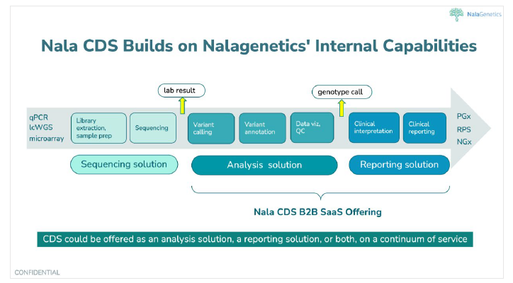
Nala CDS FLow
Appendix A

Slide 4
Overview
Clincial Decision Support
Clinical decision support (CDS) refers to a wide range of technologies, tools, and resources designed to help healthcare providers make informed decisions about patient care. The primary aim of CDS is to improve the quality of patient care by providing relevant and up-to-date information at the point of care. This can include decision trees, treatment algorithms, guidelines, drug information, and other resources that can inform clinical decision making. CDS can be delivered through a variety of channels, including electronic health records (EHRs), standalone systems, and mobile applications. The goal of CDS is to enhance the accuracy and efficiency of clinical decision making, improve patient outcomes, and reduce medical errors.

Slide 5
1. A. What features should Nala CDS have? Why?
Features
Nala Secure+: to ensure the confidentiality of patient information and to limit access to authorized users with biometric access optional.
Nala Unity Dashboard: that contain the feature of Nala CDS with the user friendly UI.
Nala Seamless: for ordering and processing of genetic tests for the users to be able to order tests and process the results within the platform by ease of use.
Nala XAnalytics: provide data analytics to help users process the sample after the sequencing, Interpretation, visualization, and monitor tracking.
Nala XReport: to generate custom format report that is easily understandable by patients and can easily to be downloadable in PDF format and print directly from the page.
Report distributor: to distribute reports to patients, healthcare professionals and other authorized users.
Data manager: to store and manage test results, patient information, and other relevant data, built in encrypted vault of cloud server and additional personal backend server (depends on the package).
Nala Event Tracker: to align between the process that already running with the users and patients real-time notifications (also can perform data analysis for Nala to measure the platform performance and the bottleneck that users and patients occurs).
Integration with electronic health records (EHRs): flexibility API to integrate with existing EHRs or the third party to ensure seamless and efficient workflow.

Slide 6
Why these features?
This nine features is the essential and core features for Nala CDS to make approach to the users and represent the Nalagenetics vision and Nala CDS target for creating the traction and revenue in 1 years time.

Slide 7
B. How would you put your plan into execution?
Execution steps:
Create Product Roadmap, timeline, and schedule.
Gain data insight of Nala CDS team resources to calculate and create the development strategy.
Gathering features requirement from internal stakeholders and users.
Define the scope and objectives of the project.
Define the Go-to-Market strategy.
Creating product backlog according the product roadmap.
Design and Develop the product by the tech team.
UAT to selected user and get feedback.
Launch the product.
Monitor and evaluate the product.

Slide 8
C. Which key teams would you involve in the effort? What are some example questions / information that you’d expect to obtain from them?
Teams:
Product (including VP of Product), ex: The roadmap of the product.
Tech (Backend, Frontend, QA, Data), ex: Th requirement of the product.
Marketing, ex: The GTM.
Finance, ex: budget for the GTM.
Legal, ex: compliances with the regulations.
Internal researchers, ex: Feedback and medical ethics of the product.

Slide 9
D. What are the risks involved for a) and b)? How will you address them?
Risks
Product risk, ex: user flow
Technical risk, ex: data security
Unfitted GTM strategy
Regulatory compliances

Slide 10
How to address them
Continuously gather feedback from users and incorporate it into the product to ensure a positive user experience.
Implement strong security protocols and data encryption to protect patient data.
Monitor the performance of the product and make necessary improvements to increase adoptionand user experience.
Deeply conduct 7 steps of GTM
Stay up-to-date with relevant regulations and laws and work with the legal and compliance team to ensure compliance.
Regularly conduct risk assessments and implement mitigation strategies to minimize the impact of another potential risks.

Slide 11
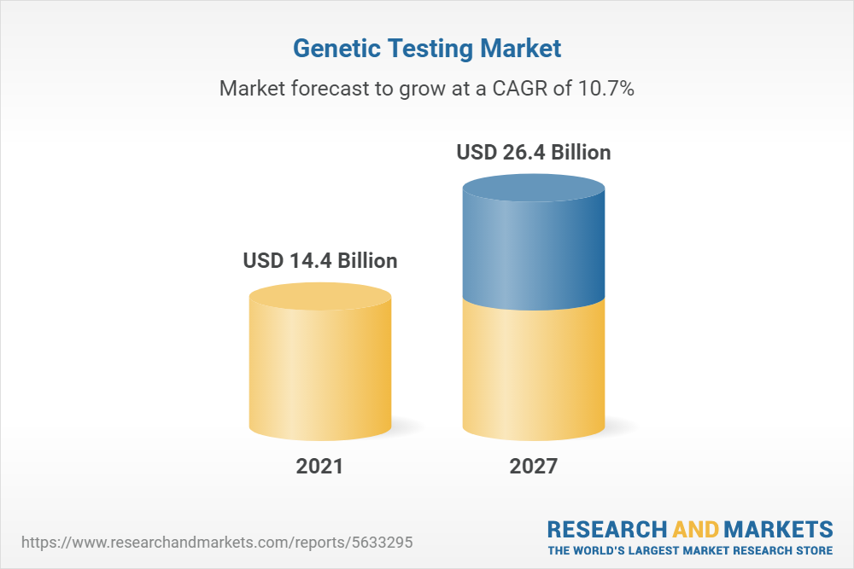
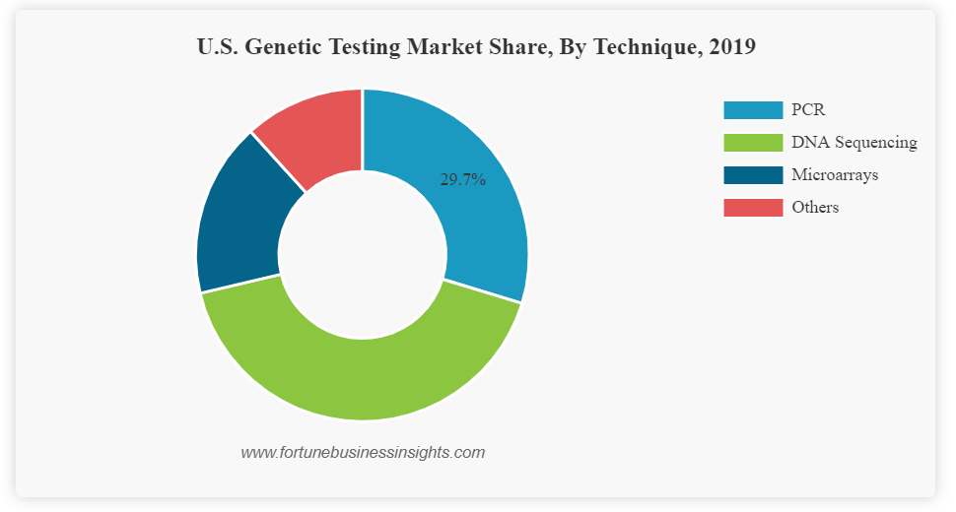
2. What are some of the trends and opportunities in genetics testing space that Nalagenetics should invest on in the short term and long term? Why?
Genetic Testing Market Overview
Genetic Testing Market_Global Size Trends Competitive Historical Forecast Analysis 2023-2029 :
https://drive.google.com/file/d/1FgGxj6Kbkm1u8lQ8SfUZXP2CM3HDWTW_/view?usp=sharing

Slide 12
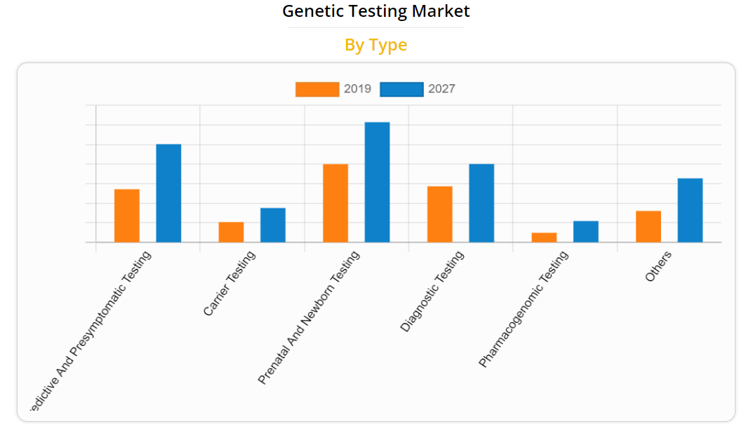
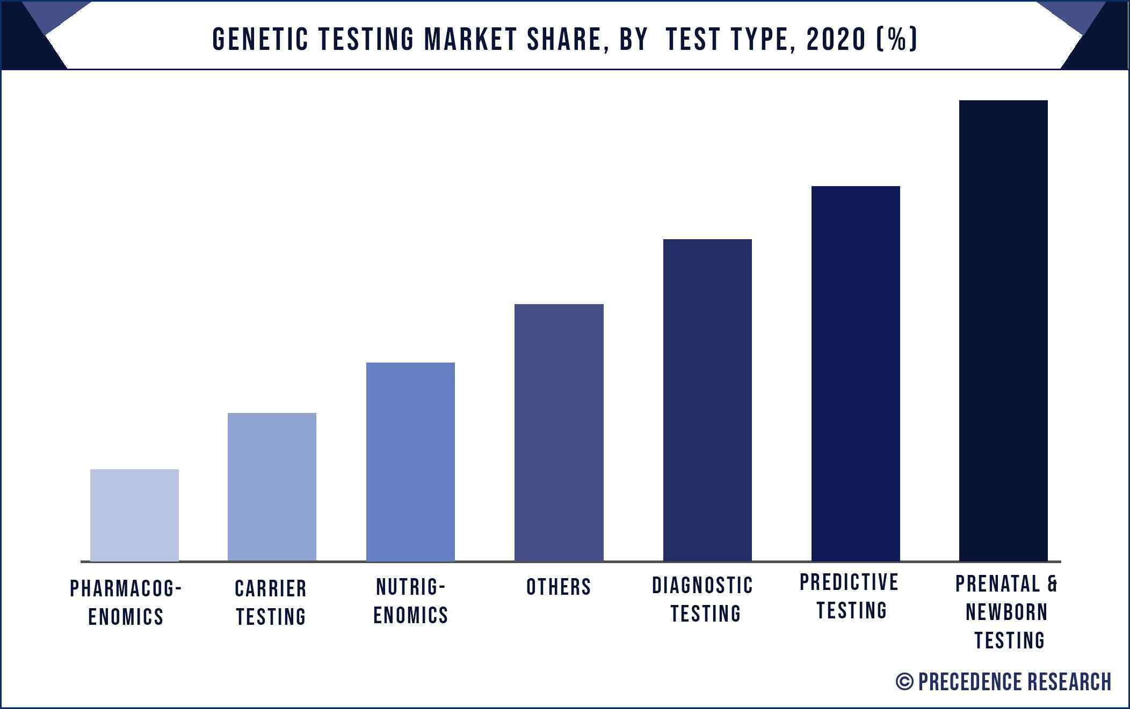
Genetic Testing Market Share (By Test Type)
Allied Market Research

Slide 13
Nalagenetics should invest on
Short term:
DNA sequencing (built-in sequencer package) (Downstream – Upstream the flow of CDS)
Long term:
Prenatal Testing
Predictive Testing
Diagnostic Testing
Future:
Gene Dopping Testing
Gene Therapy

Slide 14
Reference
https://www.researchandmarkets.com/reports/5633295/genetic-testing-market-global-industry-trends?utm_source=GNOM&utm_medium=PressRelease&utm_code=kkp9zr&utm_campaign=1730041+-+Global+Genetic+Testing+Market+(2022+to+2027)+-+Industry+Trends%2c+Share%2c+Size%2c+Growth%2c+Opportunity+and+Forecasts&utm_exec=jamu273prd
https://www.alliedmarketresearch.com/genetic-testing-market
https://www.precedenceresearch.com/genetic-testing-market
https://www.fortunebusinessinsights.com/u-s-genetic-testing-market-105034
https://www.ncbi.nlm.nih.gov/pmc/articles/PMC4203840/
https://the-dna-universe.com/2018/09/25/the-end-of-gene-doping-igem-delft-team-makes-it-possible/
https://www.ncbi.nlm.nih.gov/pmc/articles/PMC5823056/

Slide 15
Thank You

